Slide 1
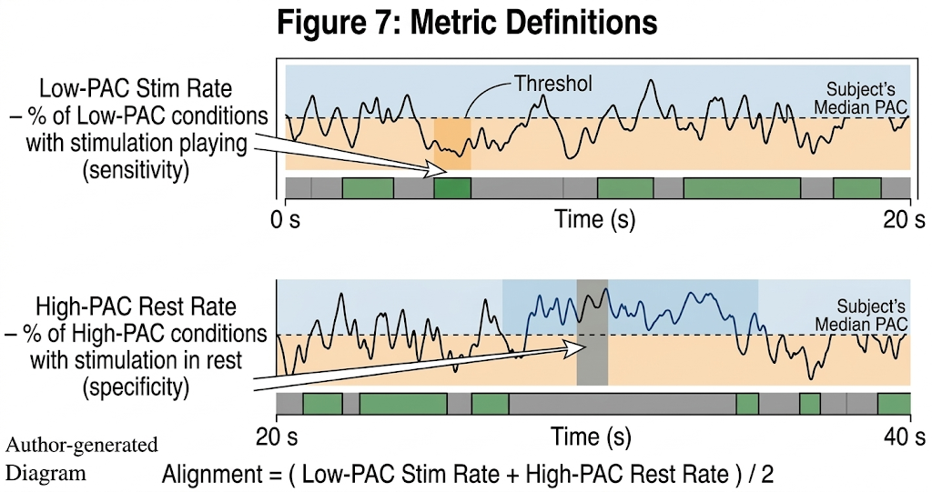
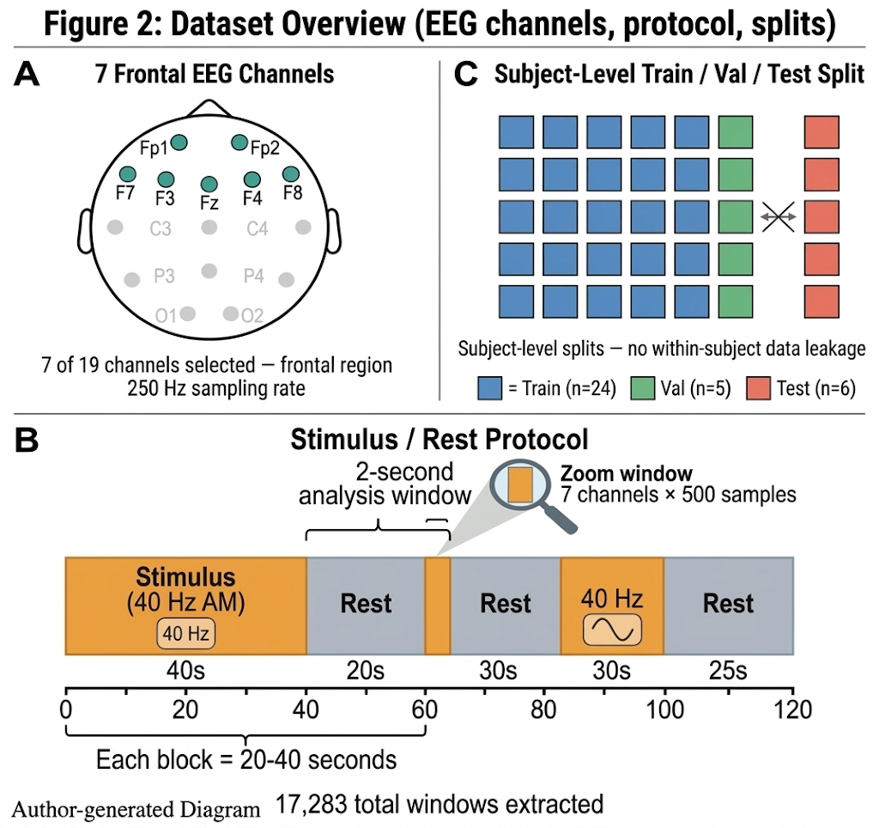
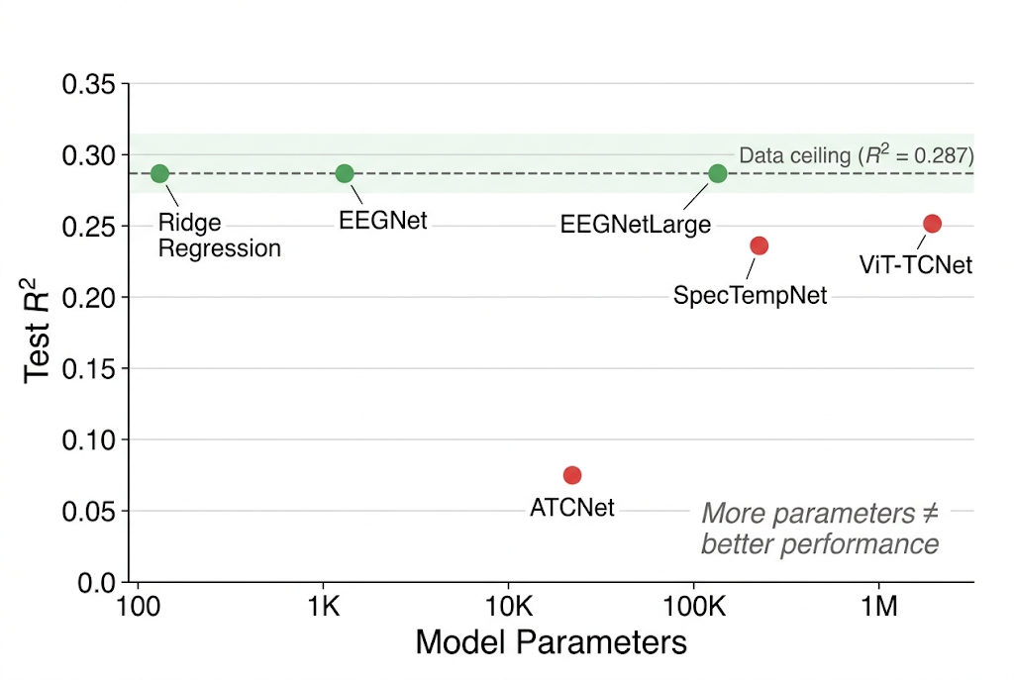
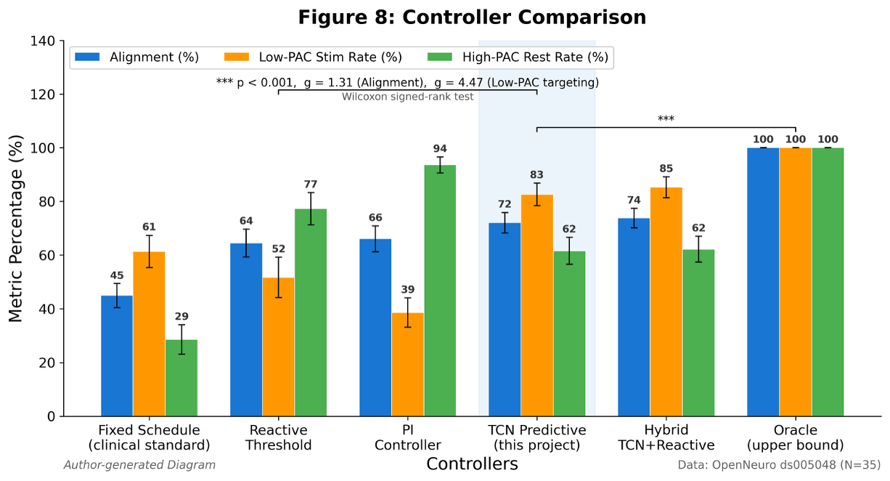
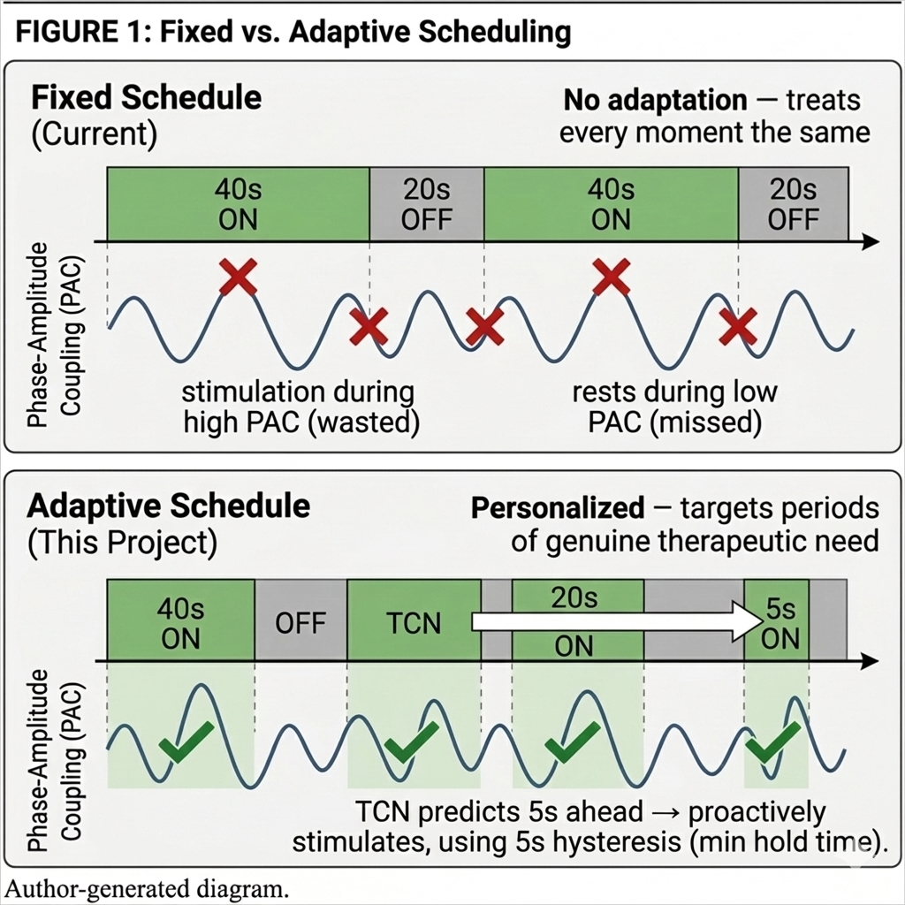
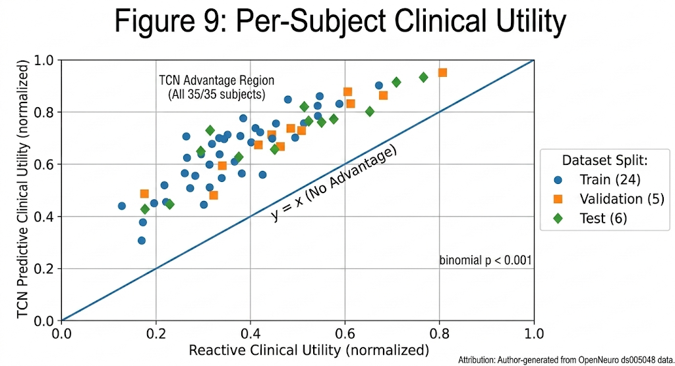
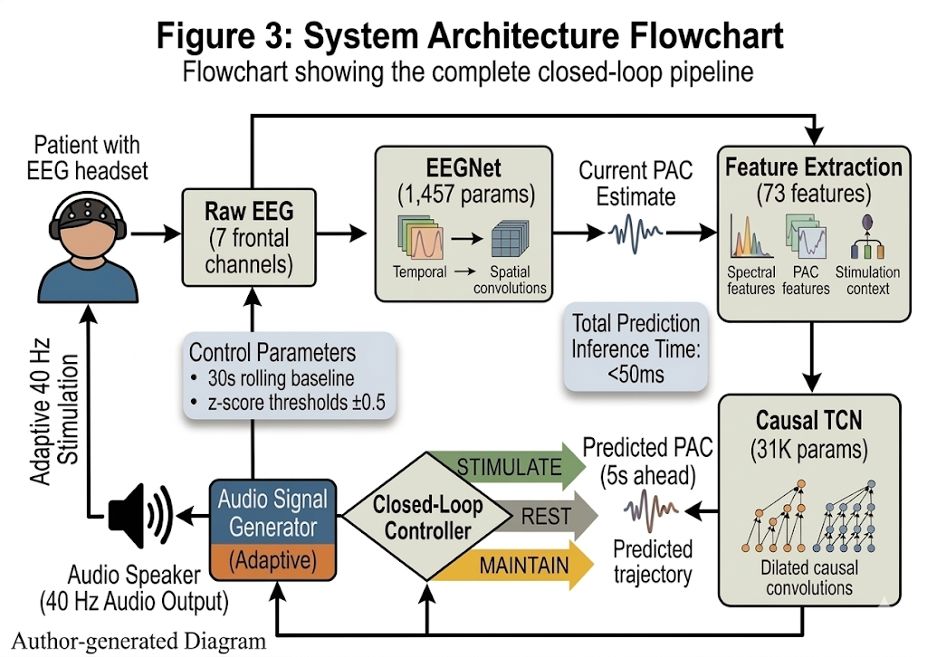
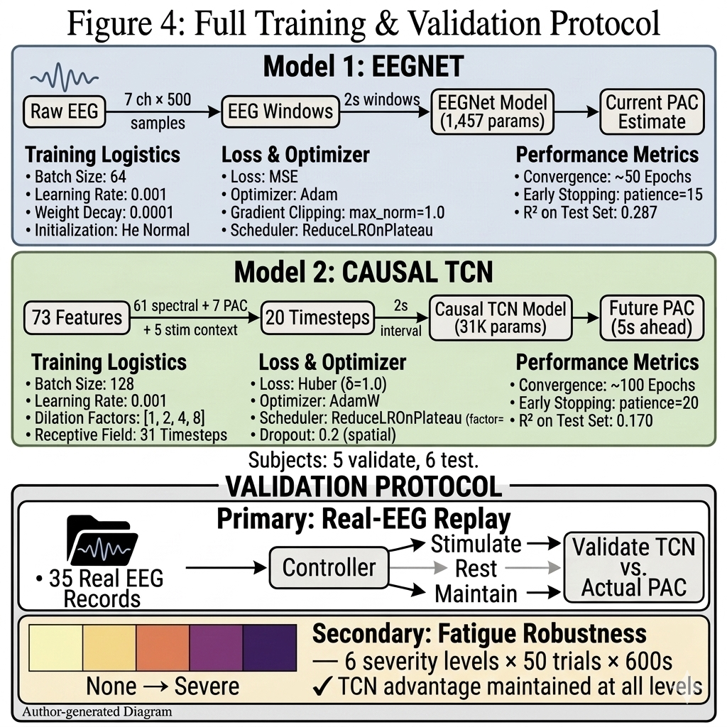
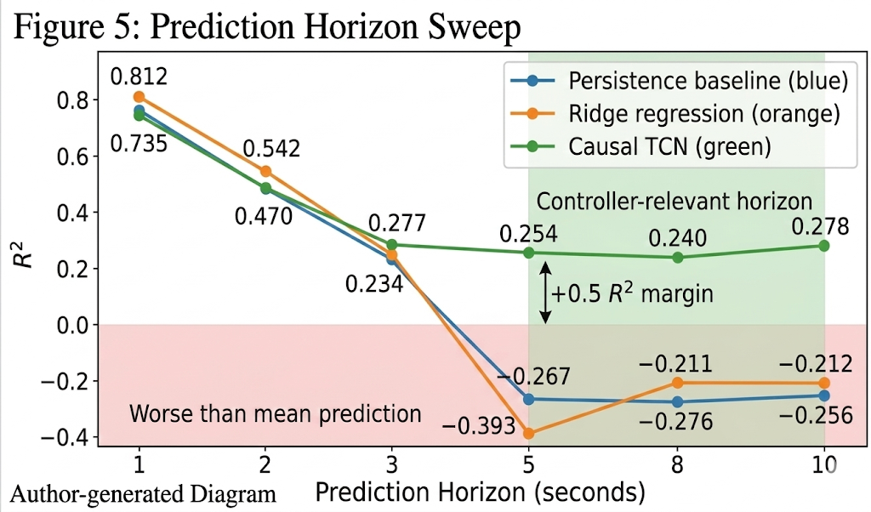
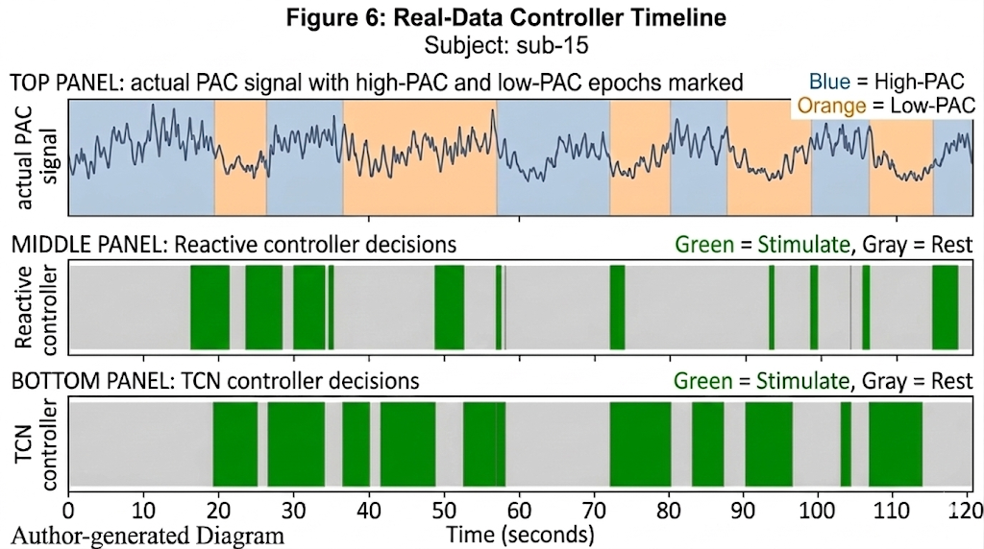
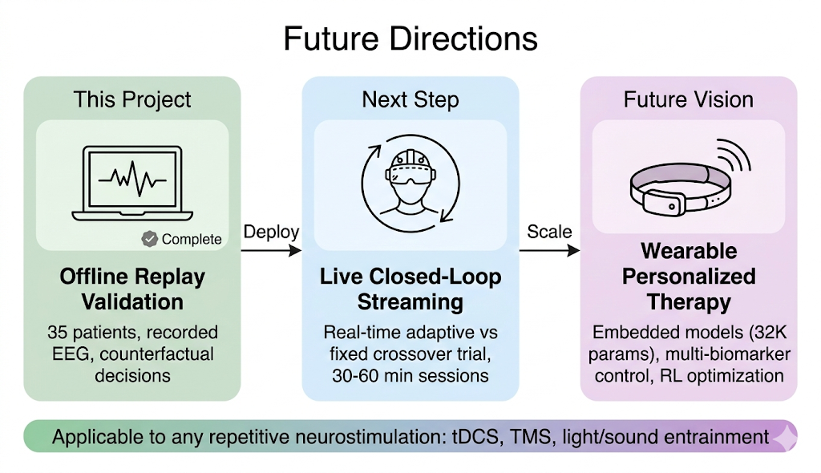

Personalized Deep Learning Model for Closed-Loop 40 Hz Entrainment to Optimize Theta-Gamma Phase Amplitude Coupling in Alzheimer’s Disease
Amaar M. Chughtai
Introduction
Model Approach
Materials
Results & Findings
Alzheimer's disease affects over 55 million people worldwide, with no cure and limited treatment options. Recent neuroscience research has revealed how 40 Hz auditory stimulation can synchronize brain gamma oscillations, reducing amyloid-beta plaques and tau tangles in animal models and showing early cognitive benefits in human clinical trials.
Current clinical protocols deliver this stimulation on a rigid fixed schedule — 40 seconds of 40 Hz auditory stimulation followed by 20 seconds of silence, cycling continuously for one hour regardless of how the patient's brain is responding. This one-size-fits-all approach ignores how some patients maintain strong theta-gamma coupling throughout a session, while others lose coupling within seconds and never fully synchronize. Prolonged repetitive stimulation causes neural habituation, where the brain progressively "tunes out" the stimulus, and coupling degrades over time. The result is wasted stimulation during periods of strong coupling and missed opportunities during periods of fading coupling.
This project asks: can we predict when a patient's brain will lose entrainment and deliver stimulation proactively, before the decline occurs?
To control stimulation proactively, the system needs to predict PAC 5-10 seconds into the future. The approach consists of two phases:
Estimate current PAC from raw EEG in real time (since live patients don't have ground-truth labels)
Predict future PAC from a history of past estimates — temporal forecasting
Stage 1: Architecture Decision for Static PAC Estimation
Dataset:
35 dementia patients, OpenNeuro ds005048 (Lahijanian 2024)
7 frontal EEG channels (Fp1, Fp2, F3, F4, F7, F8, Fz), 250 Hz
Alternating Stimulus (40 Hz AM auditory) and Rest epochs, 20-40s each
17,283 two-second windows; subject-level splits (24 train / 5 val / 6 test)
Compute: Python 3.13, PyTorch, Apple Silicon (MPS), no cloud GPU required
Result 1: TCN Predictive Control Outperforms All Alternatives
Controller performance replayed on all 35 subjects' real EEG:
Architecture | Params | Test R²
EEGNet (V1) | 1457 | 0.287
SpecTempNet (V3) | 180K | 0.236
ViT-TCNet (V4) | ~2M | 0.252
Ridge Regression (V5) | 135 coefs | 0.287
ATCNet (V8) | 25K | 0.075
EEGNetLarge (rigor) | 141K | 0.287
Simplest models (EEGNet, Ridge, EEGNetLarge) converge to R² = 0.287
Larger models perform worse due to overfitting; the 2M-parameter ViT-TCNet scored lower than the 1,457-parameter EEGNet
Conclusion: R² = 0.287 is a data ceiling (epoch-level PAC labels on 2s windows)
EEGNet matches the best R² (0.287) with only 1,457 parameters; It’s the lightest weight architecture tested, enabling real-time inference on embedded devices. provides the current PAC estimate that feeds into the temporal predictor.
Controller | Alignment | Low-PAC Targeting | PAC Gap (×10⁻⁶) | Stim %
Fixed Schedule | 45.0% | 61.4% | -6.6 (wrong direction) | 66.6%
Reactive | 64.5% | 51.7% | +21.1 | 36.7%
TCN Predictive | 72.1% | 82.6% | +30.5 | 59.7%
Oracle (upper bound) | 100.0% | 100.0% | +33.3 | 48.3%
Background
40 Hz gamma entrainment reduces amyloid load in Alzheimer's mouse models by activating microglia (Iaccarino 2016); multi-sensory stimulation reduces tau pathology and improves cognition (Martorell 2019); auditory entrainment enhances default mode network connectivity in human dementia patients (Lahijanian 2024)
Phase-Amplitude Coupling (PAC) quantifies entrainment success — how strongly gamma amplitude (38-42 Hz) locks to theta phase (4-8 Hz), measured via the Modulation Index (Tort 2010). High PAC = entrained; low PAC = lost synchronization.
Neural habituation causes repeated identical stimuli to produce progressively weaker neural responses (Thompson & Spencer 1966), making fixed schedules less effective over time
No existing system predicts future entrainment state for proactive control. Current approaches either use fixed schedules (no adaptation) or reactive thresholds (respond after PAC decline has already occurred).
TCN vs Reactive: Alignment g = +1.31, Low-PAC targeting g = +4.47, PAC gap g = +1.57 (all p < 0.001)
TCN PAC targeting gap reaches 92% of the theoretical oracle
TCN uses less stimulation than Fixed Schedule (59.7% vs 66.6%)
Reactive misses 48% of low-PAC windows that need treatment
Procedures
Stage 2: Temporal Prediction; Causal TCN
Training:
EEGNet: MSE loss, Adam optimizer, gradient clipping (max_norm=1.0), early stopping
Causal TCN: Huber loss (robust to PAC outliers), learning rate reduction on plateau, early stopping (patience=20)
All hyperparameters tuned on validation set (5 subjects); test set (6 subjects) used only for final evaluation
Validation (two independent protocols):
Primary (real data): Replayed TCN controller on all 35 subjects' actual EEG recordings — offline counterfactual decisions on real brain data. For validation, ground-truth PAC labels were used as TCN input, isolating the TCN's predictive contribution from EEGNet estimation error.
Secondary (simulation): Closed-loop simulation with neural fatigue modeling
  6 severity levels × 50 trials × 600 seconds per trial
Statistical validation:
Wilcoxon signed-rank tests (non-parametric, paired)
Bootstrap 95% confidence intervals
Hedges' g effect sizes
Compared against: Fixed Schedule, Reactive Threshold, PI Controller, Alignment Oracle (theoretical upper bound)
Since no single-window architecture could exceed R² = 0.287, I shifted the approach: instead of predicting PAC better from one snapshot, predict it further into the future from a sequence of snapshots. The Causal TCN ingests 20 seconds of history and forecasts PAC 5 seconds ahead.
 | EEGNet | Causal TCN
Purpose | Estimate current PAC from raw EEG | Predict future PAC from history
Parameters | 1457 (12 samples/param) | 31,043
Input | Raw EEG (7 ch x 500 samples) | 73 features x 20 timesteps
Architecture | Temporal + depth wise spatial conv. | Dilated causal conv (d=1,2,4,8)
Output | Current PAC Estimate | Future PAC (5s Horizon)
Key Feature | Real-time-inference | 31-step receptive field, causal (no future leakage)
Result 2: Every Patient Benefits
73 TCN input features: 61 spectral power + 7 PAC-derived (current value from EEGNet, moving averages, trends) + 5 stimulation context (on/off state, duration, session phase)
35/35 subjects (100%) show higher utility with TCN vs Reactive (binomial p < 0.001)
Advantage holds for 6 held-out test subjects never seen during training
Result 3: Advantage Increases with Fatigue
Simulation results across 6 fatigue severity levels (n = 50 trials each):
Hypothesis
Fatigue Level | Fixed Efficiency | Adaptive Efficiency | Improvement
None | 0.343 | 0.375 | +9.5%***
Mild | 0.341 | 0.375 | +10.0%***
Moderate | 0.335 | 0.366 | +9.0%***
High | 0.319 | 0.354 | +10.8%***
Severe | 0.316 | 0.352 | +11.2%***
A causal temporal convolutional network can predict future PAC at 5-10 second horizons where simpler methods fail, enabling adaptive stimulation that targets periods of genuine therapeutic need.
Goals:
Predict brain entrainment 5-10s into the future (the minimum lead time for proactive control)
Closed control loop pipeline — integrate predictions into a closed-loop stimulation controller
Validate on real patient EEG that predictive control outperforms fixed and reactive approaches
Data, Charts, & Models
***p < 0.001, Hedges' g = 1.7–2.4 (large to very large effects). Advantage grows as fatigue worsens; exactly when personalization matters most.
Result 4: Robust Across Fatigue Model Assumptions
Tested under 4 different mathematical models of neural fatigue (n = 50 trials each):
References
Iaccarino, H. F., et al. (2016). Gamma frequency entrainment attenuates amyloid load and modifies microglia. Nature, 540(7632), 230-235.
Martorell, A. J., et al. (2019). Multi-sensory gamma stimulation ameliorates Alzheimer's-associated pathology and improves cognition. Cell, 177(2), 256-271.
Tort, A. B., et al. (2010). Measuring phase-amplitude coupling between neuronal oscillations of different frequencies. Journal of Neurophysiology, 104(2), 1195-1210.
Lawhern, V. J., et al. (2018). EEGNet: A compact convolutional neural network for EEG-based brain-computer interfaces. Journal of Neural Engineering, 15(5), 056013.
Lahijanian, M., et al. (2024). Auditory gamma-band entrainment enhances default mode network connectivity in dementia patients. Scientific Reports, 14, 13153.
Thompson, R. F., & Spencer, W. A. (1966). Habituation: A model phenomenon for the study of neuronal substrates of behavior. Psychological Review, 73(1), 16-43.
Fatigue Model | Advantage | P-value | Hedges’ g
Exponential Decay | +9.0% | 1.8 × 10⁻¹⁵ | 2.31
Step Function | +6.9% | 4.4 × 10⁻¹⁴ | 1.21
Heterogeneous (50/50) | +8.9% | 2.5 × 10⁻¹⁴ | 1.71
Saturation (synaptic) | +19.0% | 1.8 × 10⁻¹⁵ | 3.66
Further Research
Deploy with live EEG streaming for real-time crossover validation (adaptive vs fixed within same session)
Record 30–60-minute sessions to capture the full habituation time course
Replace the heuristic controller with reinforcement learning for long-horizon optimization
Extend to multi-biomarker control (PAC + spectral power + connectivity)
Conclusions
At 5-10s horizons, the TCN maintains R² ≈ 0.25 while all baselines collapse below zero; a +0.5 R² margin at the operationally relevant range for proactive control
On real patient EEG: 72.1% alignment vs 64.5% reactive (p < 0.001), targeting 82.6% of low-PAC windows vs 51.7% = 60% improvement in therapeutic targeting
All 35 patients benefited, including 6 held-out test subjects — generalizes across individual EEG patterns
Adaptive advantage increases with fatigue (+9.0% to +11.2%) and holds across four fatigue model assumptions
Half of patients habituate while half do not, validating the need for personalized, not fixed scheduling
Limitation: Real-data validation uses offline replay on recorded EEG, not live closed-loop streaming. The system makes decisions on real brain data but cannot observe the brain's response to those decisions.
Acknowledgements
Data Source: OpenNeuro dataset ds005048 (Lahijanian et al., 2024). All EEG data used under open access license.

